Slide 1
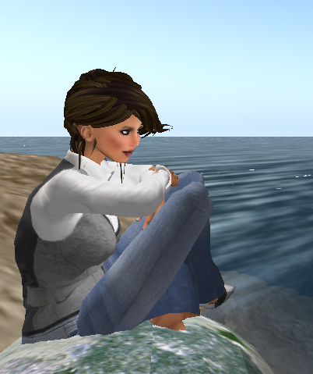
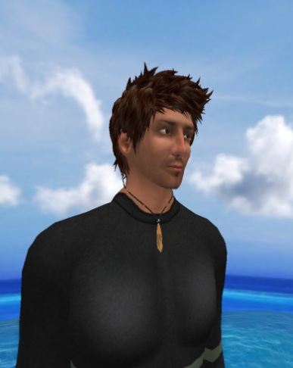
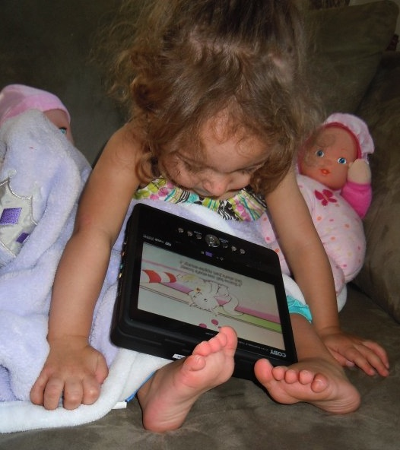
Bringing INNOVATION to DISTANCE EDUCATION for 21st Century Learners
Maryanne Maisano, Ph.D. Randy Olsen, MS, M.Ed. … The reason for CHANGE
Be the CHANGE you wish to see in the WORLD…
Gandhi

Slide 2
Connections

Slide 3
The Culture of Today’s Learner
John Dewey said, " if we teach today as we taught yesterday, we rob our children of tomorrow"

Slide 4
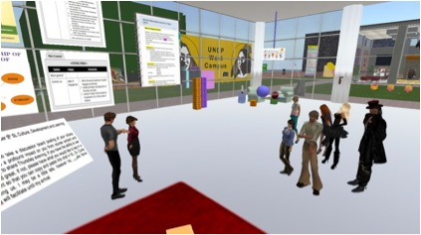
Practice Teaching Simulations and Role-Playing
Allowing every
pre-service student to
participate and interact
with colleagues
“Dr. M, What if …”
Playing out scenarios

Slide 5
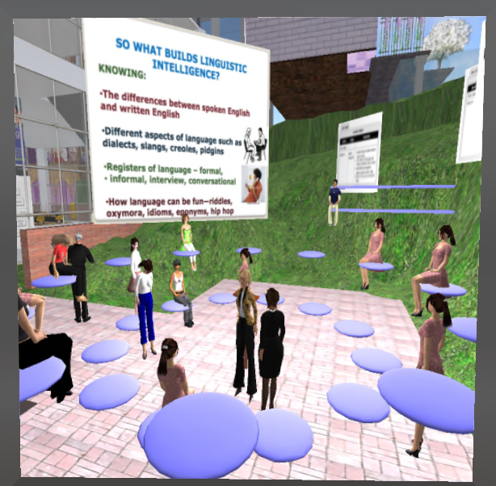
Virtual Classroom Development
Can be modified continuously, as required, for specific subject area learning and attention to individualized needs
Discussions and Professional Networking
Professional Development
Program Delivery
Conferencing
Lesson & Unit Planning

Slide 6
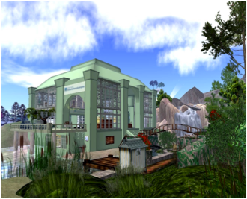
Distance Learning Opportunities for Developing Culturally Responsive Teaching
Distance Learning Opportunities for Developing Culturally Responsive Teaching with “distance” being global and communication made possible through immediate translations (ex. Czech to English and English to Czech)
Subject-Area Availability and Integration through access to the Internet and human resources

Slide 7
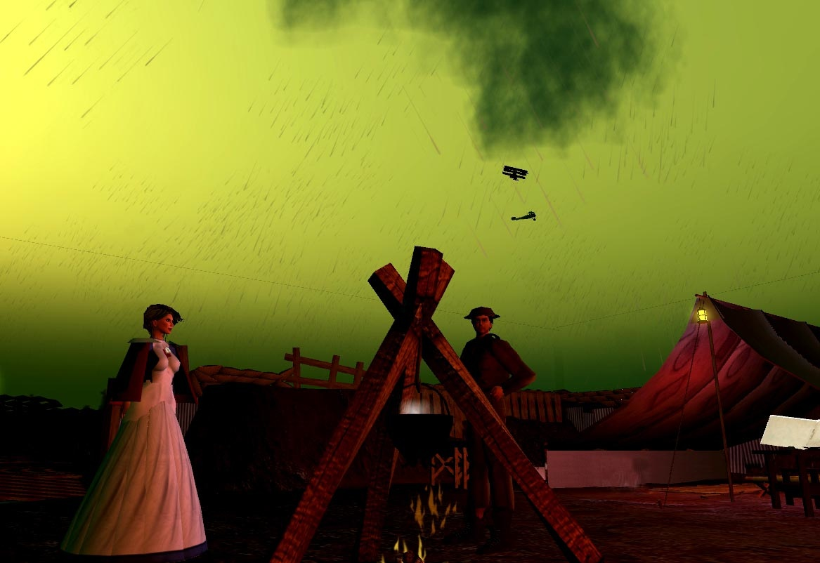
Simulated “Field” Experiences
Simulated “Field” Experiences that takes students to “courthouses, hospitals, environmental sites, geographic regions”
art galleries, planetarium simulations, geographic region or any other great teaching and learning materials one can actually reach virtually in Second Life

Slide 8
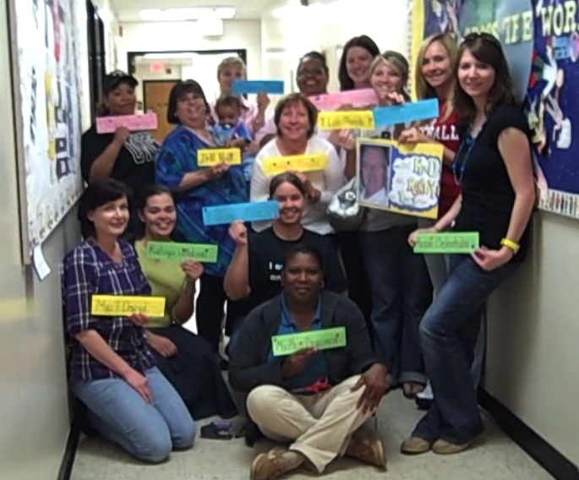
C
Connections

